Slide 1
Advance Computer Architecture

Slide 2
Advance Computer Architecture
5. Multicore Processor Design ( 6 Hrs)
5.1 Introduction to Multicore Processors
5.2 Design Principles of Multicore Processors:
Core Integration
Instruction Parallelism
Performance Metrics
By:
Er. Ram Thapa
Er. Baburam Shrestha

Slide 3
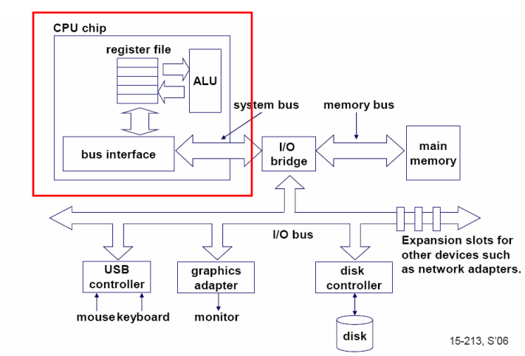
Single Core Computer
A single-core computer uses a microprocessor with a single CPU on its die, performing the fetch-decode-execute cycle one at a time
Generally slower than multi-core systems because they can only run on one thread at a time.

Slide 4
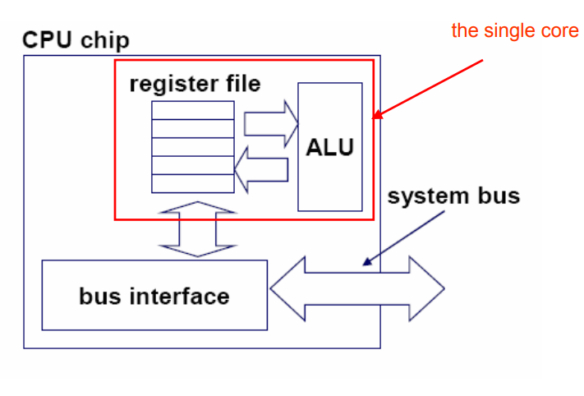
Single Core Processor
A single-core processor is a microprocessor with a single CPU on its die, performing the fetch-decode-execute cycle one at a time, as it only runs on one thread.
Generally slower than multi-core systems because they can only run on one thread at a time.
We need multi Processor to speed up the performance and efficiency.

Slide 5
Problem with Single Core Processor
Difficult to make single-core clock frequencies even higher
Deeply pipelined circuits:
  heat problems
  speed of light problems
  difficult design and verification
  arge design teams necessary
  server farms need expensive air-conditioning
Many new applications are multithreaded
General trend in computer architecture (shift towards more parallelism)
We need multi Processor to speed up the performance and efficiency.

Slide 6
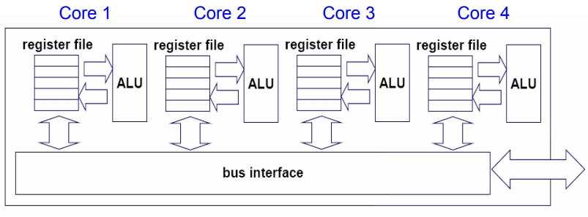
Multicore Processors
A multicore processor ia a single integrated(two or more independent processing units commonly known as cores) within a single chip, allowing parallel execution of tasks and improving performance.

Slide 7
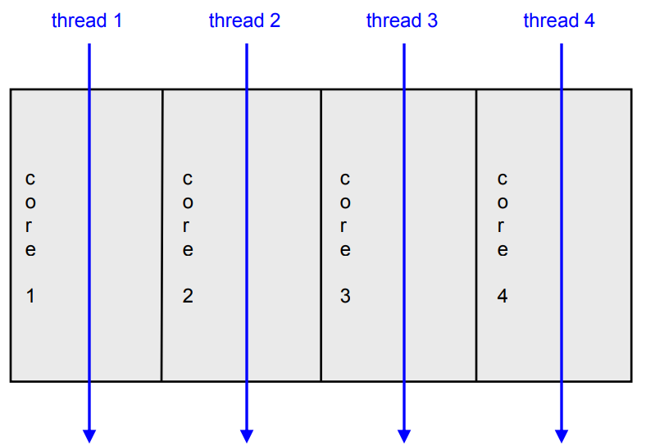
Multicore Processors
The cores run in parallel.

Slide 8
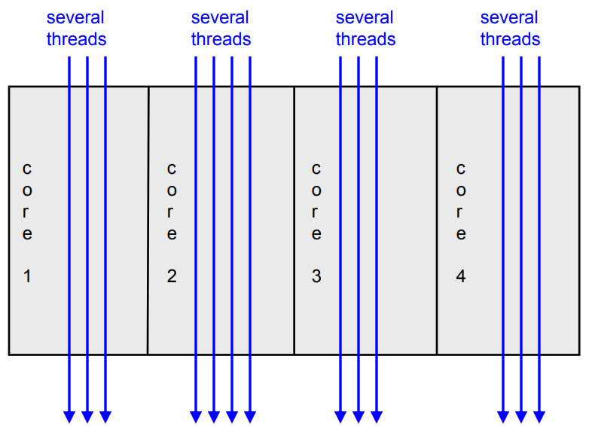
Multicore Processors
Within each core, threads are time-sliced (just like on a uniprocessor)

Slide 9
Multicore Processors
There are many different multicore processors architectures, which may vary in terms of
  Number of cores
  Number of core types
    Homogeneous(symmetric) cores
    Heterogeneous(asymmetric) cores
  Number and level of caches
  How cores are interconnected
  Isolation
    Physical Isolation
    Temporal Isolation

Slide 10
Multicore Processors
Number of cores:
  Different multicore processors often have different numbers of cores.
For example, a quad-core processor has four cores.
  The number of cores is usually a power of two.
Number of core types
  Homogeneous(symmetric) cores
    All of the cores in a homogeneous multicore processor are of the same type.
    Typically the core processing units are general-purpose central processing units that run a single multicore operating system.
  Heterogeneous(asymmetric) cores
    Heterogeneous multicore processors have a mix of core types that often run different operating systems and include graphics processing units.

Slide 11
Multicore Processors
Number and level of caches
  Multicore processors vary in terms of their instruction and data caches, which are relatively small and fast pools of local memory.
How cores are interconnected
  Multicore processors also vary in terms of their bus architectures.
Isolation
  Physical Isolation
    It ensures that different cores cannot access the same physical hardware (e.g., memory locations such as caches and RAM).
  Temporal Isolation
    It ensures that the execution of software on one core does not impact the temporal behavior of software running on another core.

Slide 12
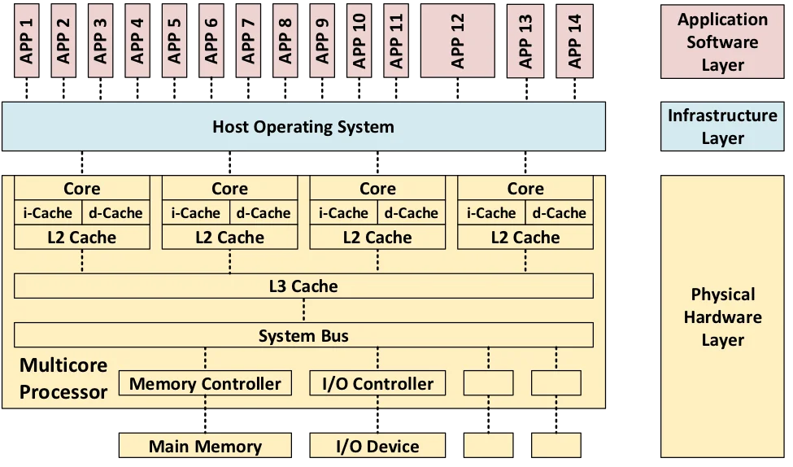
Homogeneous Multicore Processors

Slide 13
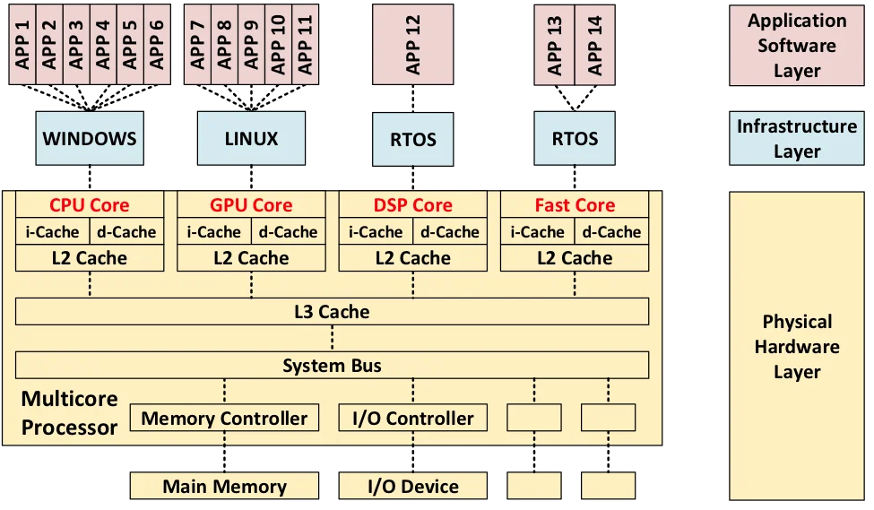
Heterogeneous Multicore Processors

Slide 14
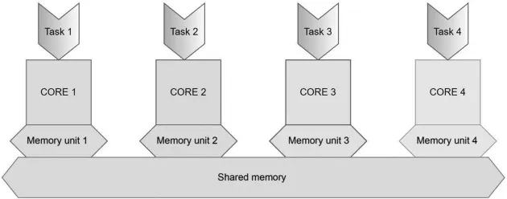
Design Principle of Multicore Processor
Multicore processors are designed to improve computational efficiency through parallel execution, optimized resource management, and performance scalability.
Key design principles include:
  Core integration
  Instruction-level Parallelism
  Performance metric

Slide 15
Core Integration
Core integration involves combining multiple processor cores on a single chip to enable parallel execution and improve performance.
The keys to consider while integrating the core for multicore processor
  Number of Cores: More cores increase parallel processing capability.
  Core Heterogeneity: Cores can be homogeneous or heterogeneous.
  Cache Structure: Each core has a private L1 cache; Cores may share L2 and L3 caches to reduce latency and improve data access.
  Interconnection Network: As core count increases, communication bottlenecks arise. Network on Chip (NoC) improves scalability and efficiency by applying networking concepts.
Software Considerations:
  Parallel programming is required to fully utilize multicore performance.
  Developers must manage multiple threads, synchronization, and workload distribution efficiently.

Slide 16
Instruction-Level Parallelism
All processors since about 1985 use pipelining to overlap the execution of instructions and improve performance. This potential overlap among instructions is called instruction-level parallelism (ILP).
It is a set of techniques used in computer architecture to execute multiple instructions simultaneously within a CPU core, enhancing computational speed and efficiency. This is achieved through methods such as pipelining, superscalar execution etc.
Pipelining involves dividing the execution process into several stages, allowing multiple instructions to be in different stages of execution simultaneously, which improves throughput.
Superscalar execution allows a processor to issue and execute more than one instruction per clock cycle by having multiple execution units that handle different types of instructions concurrently.

Slide 17
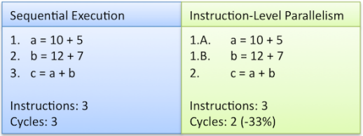
Instruction-Level Parallelism
Approaches to Instruction-Level Parallelism
Dynamic ILP (Hardware-Based Approach)
Static ILP (Software-Based Approach)
Complementary Use of Both Approaches

Slide 18
ILP Approached to Exploit
1. Dynamic ILP (Hardware-Based Approach)
The hardware automatically detects and schedules independent instructions at runtime.
Techniques include:
  Out-of-Order Execution: Executes instructions as soon as operands are available, even if they are out of program order.
  Branch Prediction: Reduces stalls by predicting and preloading future instructions.
  Speculative Execution: Executes instructions ahead of time and rolls back if mispredicted.
  Register Renaming: Eliminates false dependencies by mapping registers dynamically.

Slide 19
ILP Approached to Exploit
2. Static ILP (Software-Based Approach)
The compiler restructures code to expose parallelism before execution.
Techniques include:
  Loop Unrolling: Expands loops to reduce branch overhead and increase parallel execution.
  Software Pipelining: Reorders instructions to maximize parallel execution.
  Vectorization (SIMD): Uses special instructions to perform multiple computations in a single step.
3. Complementary Use of Both Approaches
Modern processors combine both methods:
  Compilers optimize code statically to expose ILP.
  Processors exploit additional parallelism dynamically at runtime for further efficiency.

Slide 20
Instruction-Level Parallelism(E.g.)
To exploit loop-level parallelism and improve performance, we convert it into instruction-level parallelism (ILP) using the following techniques:
Loop Unrolling (Static ILP): The compiler duplicates loop iterations to reduce control overhead and expose more independent instructions.
Example: Unrolling the loop 4 times to execute multiple iterations in parallel.
for (i=0; i<=996; i+=1) {
x[i] = x[i] + y[i];
}
for (i=0; i<=996; i+=4) {
x[i] = x[i] + y[i];
x[i+1] = x[i+1] + y[i+1];
x[i+2] = x[i+2] + y[i+2];
x[i+3] = x[i+3] + y[i+3];
}
Reduces branch instructions and increases instruction overlap.
Helps in utilizing multiple execution units in a superscalar processor

Slide 21
Instruction-Level Parallelism(E.g.)
2. Software Pipelining (Static Scheduling)
The compiler reorders instructions across iterations to maximize parallel execution while avoiding dependencies.
Example: Instead of executing one iteration at a time, instructions from different iterations are interleaved.
3. Out-of-Order Execution (Dynamic ILP)
Modern processors dynamically schedule instructions to execute in parallel if there are no dependencies.
Hardware reorders loads, adds, and stores to maximize execution efficiency.

Slide 22
Instruction-Level Parallelism(E.g.)
4. SIMD (Single Instruction, Multiple Data) Processing
Uses vectorized instructions to process multiple data elements per instruction.
Example: On SIMD-capable hardware, one instruction can compute four additions at once: x[i:i+3] = x[i:i+3] + y[i:i+3]; // Adds 4 elements in parallel
Found in vector processors and GPUs for high-performance parallelism.
5. Hardware Loop Unrolling (Dynamic Loop Unrolling)
Some architectures dynamically detect independent loop iterations and execute them in parallel using loop buffer optimizations.

Slide 23
ILP Dependency
Dependencies define constraints on instruction execution order.
Data Dependencies (True Dependencies): Occur when instruction j depends on the result of instruction i.
Example:
ADD R1, R2, R3 # R1 = R2 + R3
SUB R4, R1, R5 # R4 depends on R1
Transitive Dependency: If j depends on k and k depends on i, then j is also dependent on i.
Name Dependencies (False Dependencies): Occur when two instructions use the same register or memory location without data flow.
    Anti Dependence (WAR – Write After Read): j writes a register/memory before i reads it.
    Output Dependence (WAW – Write After Write): Both i and j write to the same register/memory.
Solution: Rename registers or use different memory locations.

Slide 24
ILP Dependency
3. Control Dependencies: Occur when instructions depend on branch outcomes.
Example:
BEQ R1, R2, LABEL # Branch to LABEL if R1 == R2
ADD R3, R4, R5 # Dependent on branch outcome
Rules:
    Instructions dependent on a branch must not execute before the branch.
    Instructions not dependent on a branch must not be delayed due to the branch.

Slide 25
ILP Dependency
4. Relaxing Dependencies: Dependencies can be rearranged if program correctness
is preserved.
Two key properties must hold:
  Exception Behavior: Reordering should not change visible exceptions.
  Data Flow: Instructions must still get the correct data.
5. Liveness of Data
Live Data: Needed for future computations.
Dead Data: No longer used and can be safely discarded.
By handling dependencies properly, ILP can be maximized, improving execution speed without violating program correctness.

Slide 26
ILP Data Hazards
A hazard occurs when a dependency causes execution issues in the pipeline.
RAR (Read After Read): Not a hazard (safe to execute in parallel).
RAW (Read After Write) – True Dependency: j reads a value before i writes it.
WAR (Write After Read) – Anti Dependence: j writes before i reads.
WAW (Write After Write) – Output Dependence: Both i and j write to the same register.

Slide 27
Performance Metric
Multicore CPU performance is evaluated using various metrics based on time, rate, and resource utilization:
1. Time-Based Metrics:
Response Time: Time between a user request and system response.
Execution Time: Total time required to complete a program.
Memory Latency: Delay between a memory request and data availability (CAS latency).
2. Rate-Based Metrics:
Throughput: Average rate of successful processes executed.
Memory Bandwidth: Rate at which data is transferred between CPU cores and RAM.
3. Resource Utilization Metrics:
Energy Consumption: Power needed to execute a program.
Memory Contention: Percentage of cores competing for RAM access at the same time.

Slide 28
Performance Metric
Performance metrics are the measurements of the system performance or activity.
The metrics selection depends upon the services provided by the system because metrics quantify the required output of the system.
Metrics can be classified in three main classes:
  HB (Higher is Better): include metrics like throughput, higher values for this metric are preferred.
  LB (Lower is Better): include metrics like execution time, where lower values for this metrics preferred.
  NB (Nominal is Best): include metrics like power, with the median values being optimal in this case.

Slide 29
Pros of Multicore Processors
Energy Efficiency: Reduces power consumption and heat, extending battery life.
True Concurrency: Enables parallel processing for better multitasking.
Performance Boost: Faster execution with reduced resource access latency.
Isolation: Minimizes software interference, enhancing robustness.
Reliability: Supports fault tolerance and system recovery.
Obsolescence Avoidance: Keeps up with advancing chip technology.
Cost Savings: Reduces hardware needs by integrating multiple cores.

Slide 30
Cons of Multicore Processors
Shared Resources: Competition for memory, cache, and I/O can cause bottlenecks.
Interference: One core's workload may impact others, breaking isolation.
Concurrency Defects: Risk of deadlocks, race conditions, and priority inversion.
Non-determinism: Unpredictable execution due to interrupts and lock conflicts.
Analysis Complexity: Harder to predict execution times and interference effects.
Certification Challenges: Meeting safety standards for real-time applications is difficult.

Slide 31
Advance Computer architecture
[1] https://ieeexplore.ieee.org/document/8262970
[2] https://insights.sei.cmu.edu/blog/multicore-processing/
[3] Jernej Barbic 15-213, Spring 2007
[4] https://eecs.ceas.uc.edu/~wilseypa/classes/eece7095/lectureNotes/ilp/ilp.pdf
[5] https://www.cs.cmu.edu/~fp/courses/15213-s07/lectures/27-multicore.pdf
[6] Computer Architecture A Quantitative Approach (Fifth Edition) (John L. Hennessy, [7] David A. Patterson).pdf pg 147-150
[8] https://www.cse.wustl.edu/~jain/cse567-13/ftp/multicore/index.html#wikipedi

